Slide 1
Goal Oriented Action Planning
From "Goal Oriented Action Planning for a Smarter AI", Brent Owens, 04-2014

Slide 2
Definition
Goal Oriented Action Planning (GOAP) is an AI system that will easily give your agents choices and the tools to make smart decisions without having to maintain a large and complex finite state machine.

Slide 3
What is GOAP ?
Goal Oriented Action Planning is an artificial intelligence system for agents that allows them to plan a sequence of actions to satisfy a particular goal.
Depends on :
  the goal
  current state of the world
  current state of the agent
GOAP can choose the best sequence based on what preconditions are available.

Slide 4
Wood Cutter
Goal : Make Firewood
Actions :
  Chop Log
  Drop Off Firewood
  Get Axe
  Collect Branches
Sequences :
  Need Firewood → Get Axe → Chop Log
  Need Firewood → Collect Branches

Slide 5
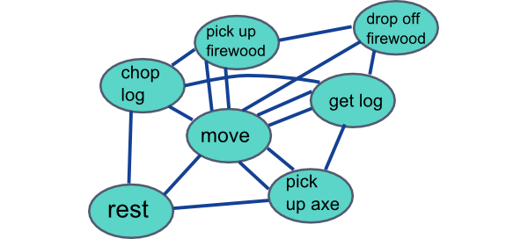
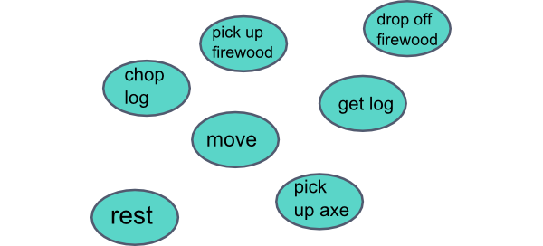
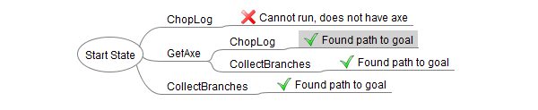
Decoupling the actions
FSM :
GOAP:

Slide 6
Action
An action is something that the agent does
An action is encapsulated, and should not have to worry about what the other actions are
Each action is given a cost
Wood Cutter Sequences :
  Need Firewood → Get Axe (2) → Chop Log (4)
  Need Firewood → Collect Branches (8)
  "Picking up an axe and chopping a log has a greater utility than collecting branches"

Slide 7
Preconditions and effects
A precondition is the state that is required for the action to run
The effects are the change to the state after the action has run
Get Axe Cost: 2.
  Preconditions: "an axe is available", "doesn’t have an axe".
  Effect: "has an axe".
Chop Log Cost: 4.
  Preconditions: "has an axe".
  Effect: "make firewood"
Collect Branches (Cost 10)
  Preconditions: none.
  Effect: "make firewood"

Slide 8
GOAP Planner
The GOAP planner is a piece of code that looks at actions' preconditions and effects, and creates queues of actions that will fulfill a goal.
Goal
Planner
World state
Sequence of actions
Actions

Slide 9
GOAL: "make firewood"
Current State: "doesn’t have an axe", "an axe is available"
Can action ChopLog run?
NO - requires precondition "has an axe"
Cannot use it now, try another action.
Can action GetAxe run?
YES, preconditions "an axe is available" and "doesn’t have an axe" are true.
PUSH action onto queue, update state with action’s effect
New State
"has an axe"
Remove state "an axe is available" because we just took one.
Can action ChopLog run?
YES, precondition "has an axe" is true
PUSH action onto queue, update state with action’s effect
New State
"has an axe", "makes firewood"
We have reached our GOAL of "make firewood"
Action sequence: GetAxe -> ChopLog

Slide 10
GOAP Planner
The planner will run through all possibilities to find the best solution.
GetAxe -> ChopLog (total: 6)
GetAxe -> CollectBranches (total: 10)
CollectBranches (total: 8)

Slide 11
Procedural Preconditions
Sometimes, actions need to do a little more processing to determine whether they can run.
Example : Get Axe action
  Precondition : "An axe is available"
    Search the world for an axe
    Determine if axe is accessible (pathfinding)
Could change during the game (procedural)
Could be performed on other thread (coroutine)
Also procedural Effects

Slide 12
GOAP and FSM
- Get a goal
- Plan with GOAP
Idle
List of actions
empty
List of actions not empty
PerformAction
MoveTo

Slide 13
Conclusion
"With GOAP, you can create a large series of actions without the headache of interconnected states that often comes with a Finite State Machine. Actions can be added and removed from an agent to produce dynamic results, as well as to keep you sane when maintaining the code. You will end up with a flexible, smart, and dynamic AI."

